Slide 1

A Project Report On
AUTOMATING EMAILS
Supervised By:
Dr. Pratik Roy
Submitted By:
Abhishek Singh ; Khushi Singh ; Rishabh Saxena
Siddhant Sahay ; Tanishka Sharma (W2)

Slide 2
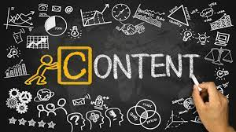
Table of Content:
About the topic .
Motivation
Where we can use Automating Emails?
Benefits of Automating Emails.
Modules Used
Steps Implemented
Source Code
Output
Conclusion
Bibliography

Slide 3

Automating Emails:
Email automation is a way to create
emails that reach the right people
with the right message at the right
moment—without doing the work
every time, sending automated
messages leveraging a marketing
automation tool.

Slide 4
Motivation:
We have read and listen about emails a lot and we discuss that can we send a email automatically and we decided to do this as our project .
we choose python as our programming language to do this project because python is easy language . We can write a code in python easily

Slide 5

Where We can use Automating Emails?
Welcome Emails
Relationship Building Emails
Targeted SAAS promotional emails
Birthday emails
Abandoned cart emails

Slide 6

Benefits of Automating Emails:
Re-engage lost customers
Deliver the right information to the right people
Increase your revenue
Improve team efficiency
Retain more customers

Slide 7

Modules Used:
Email Module
SMTP Module
Glob Module

Slide 8

Glob Module:
In Python, the glob module is used to
retrieve files/pathnames matching a
specified pattern.
The pattern rules of glob follow standard
Unix path expansion rules. It is also
predicted that according to benchmarks it
is faster than other methods to match
pathnames in directories.

Slide 9
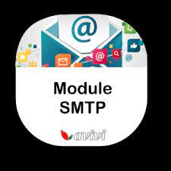
SMTP Module:
Simple Mail Transfer Protocol (SMTP)
is a protocol, which handles sending e-mail
and routing e-mail between mail servers.
Python provides smtplib module, which defines
an SMTP client session object that can be used
to send mail to any Internet machine with an
SMTP or ESMTP listener daemon.

Slide 10
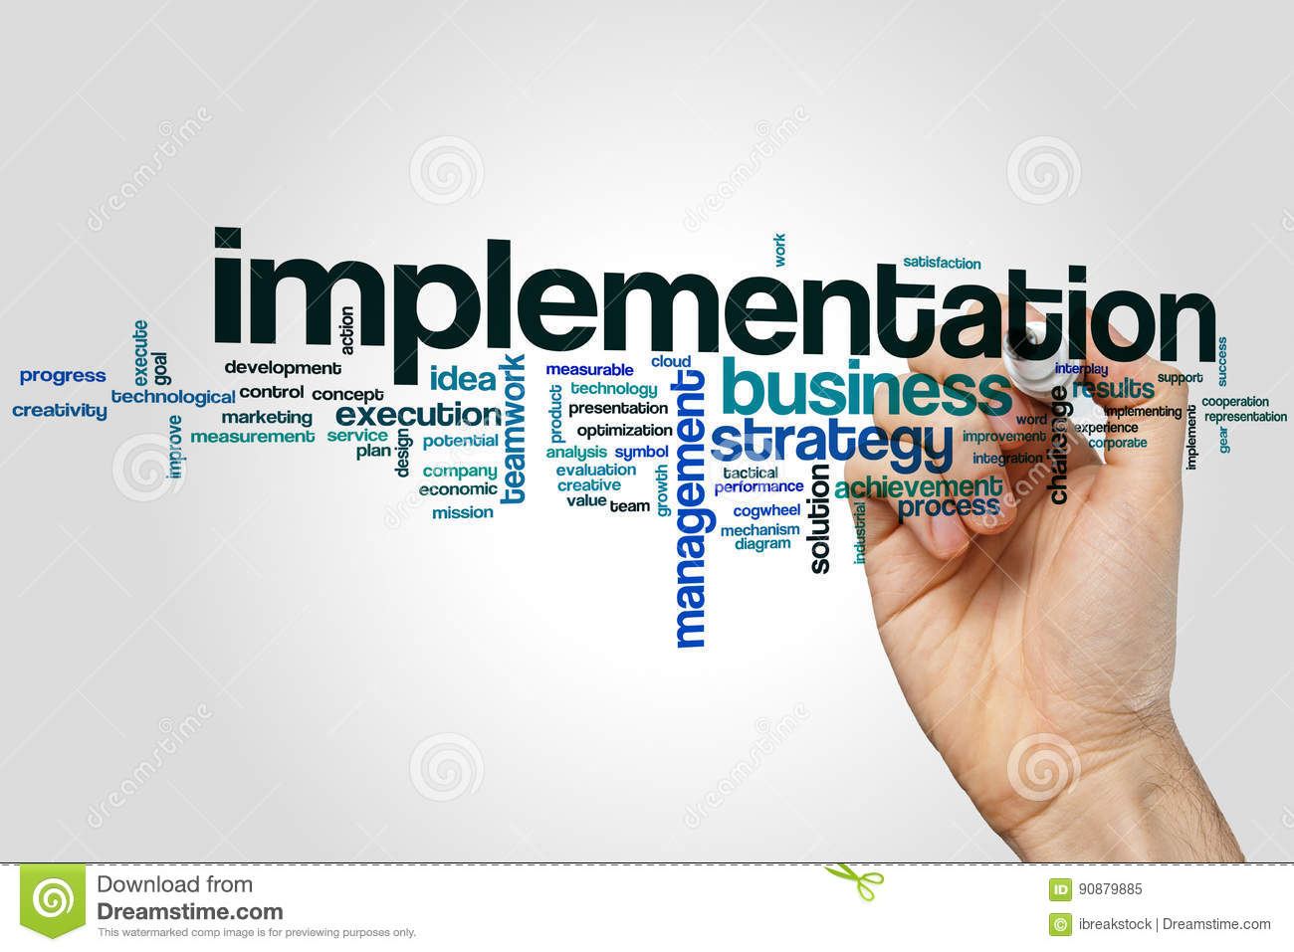
Steps implemented:
Import modules.
Set up a connection to our email server.
Build the message content.
Let’s look at how to attach pictures and multiple attachments.
The last step is to send the email.

Slide 11
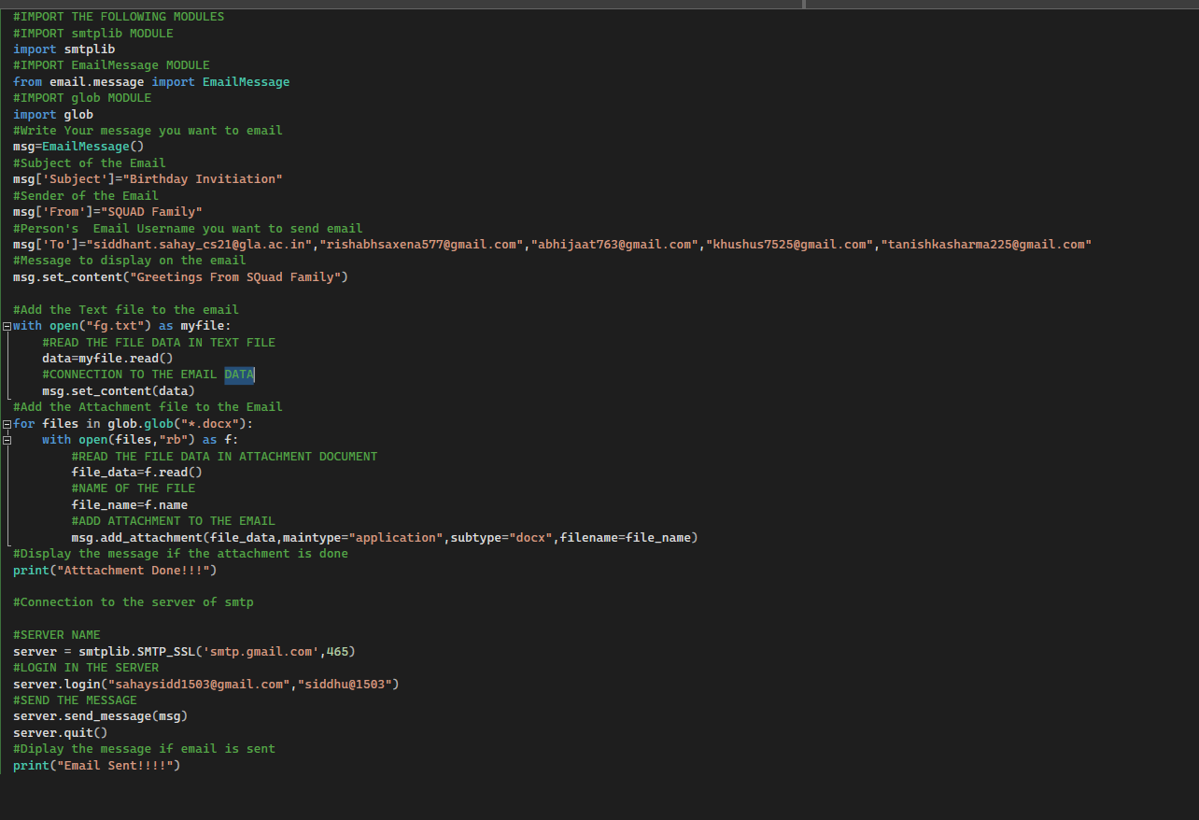
Source code:

Slide 12
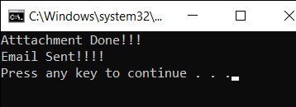

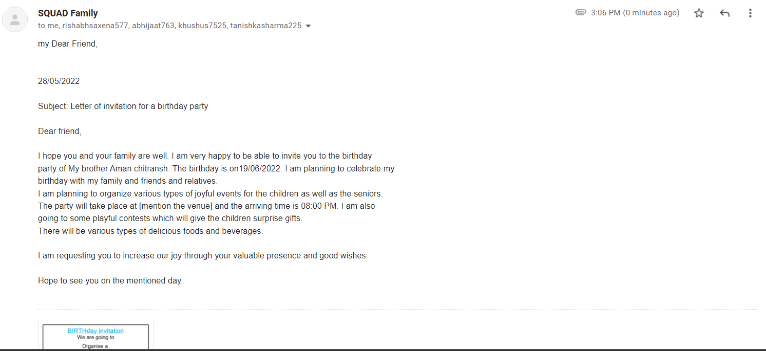
Output:

Slide 13
Conclusion:
It was a wonderful and learning experience while working on this project.
The joy of work and the thrill involved while tackling various problems and challenges gave us a feel of developing industry.
We enjoyed each and every bit of work I had put into this project.

Slide 14
Bibliography:
www.geeksforgeeks.org
www.tutorialspoint.com
https://www.salesmate.io/blog/email-automation/
https://docs.python.org/3/library/smtplib.html

Slide 15


